Slide 1
Team Hotspotter
Developers
Dylan Williams Quality Assurance
Spencer Smith Customer Proxy
Nathan Reinhardt Scrum Master
Client
Dr. Igor Crk Southern Illinois University Edwardsville Department of Computer Science Edwardsville, IL 62026-1656

Slide 2

What is A Hotspot?
Area of instability within a codebase
Frequently changed files, many commits
Recently modified files, cooldown over time
Line additions vs. Line deletions
Bug fixing commits vs. Regular commits
Dylan Williams

Slide 3
Project Domain
Developers
Tracking bug-fixing commits
Testing code before committing code into the master build
Project Managers
Assigning troublesome tasks to more experienced developers
Open Source Contributors
Allows contributors to grow and develop based on the history of their contributions
Dylan Williams

Slide 4
Project Requirements
No client-required platform
Semi-Agile approach
Behavior Driven Development
Continuous access to product
Client validation every sprint
Dylan Williams

Slide 5
Project Capabilities
Clone a public git based repository
Run metrics on cloned repository
Create graph of metrics
Export data to a CSV file
Spencer Smith

Slide 6




Project Architecture
Spencer Smith

Slide 7
DEMO DEMO DEMO DEMO DEMO DEMO DEMO DEMO
Spencer Smith

Slide 8



Project Management
Defined GIT practices
Collaboration and responsibility
Jira
Agile Planning
Jenkins
Automated quality/tests
Automated deployment
Nathan Reinhardt

Slide 9
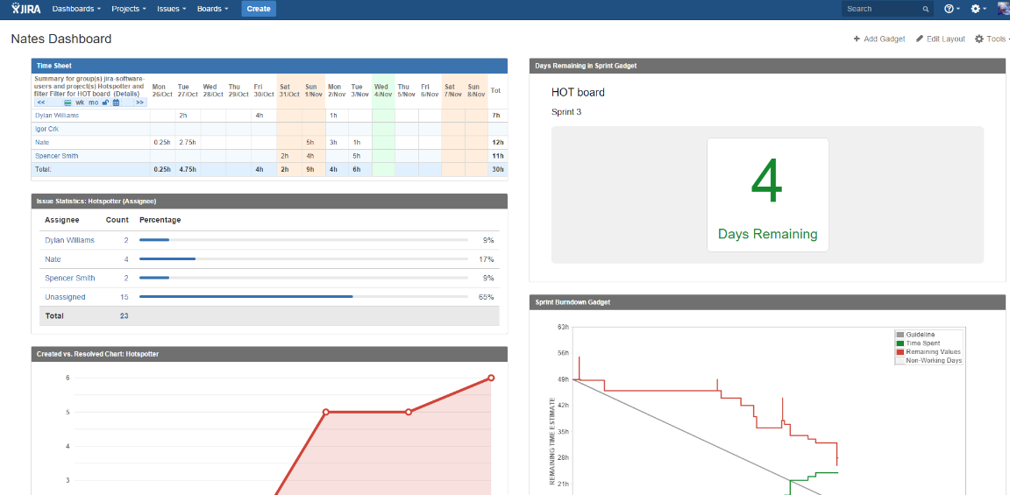
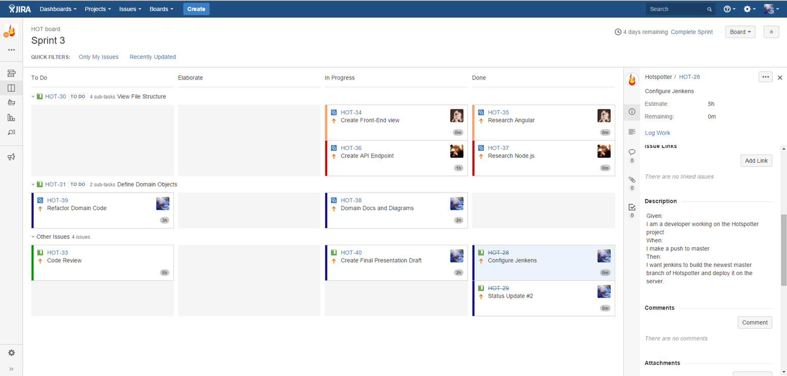
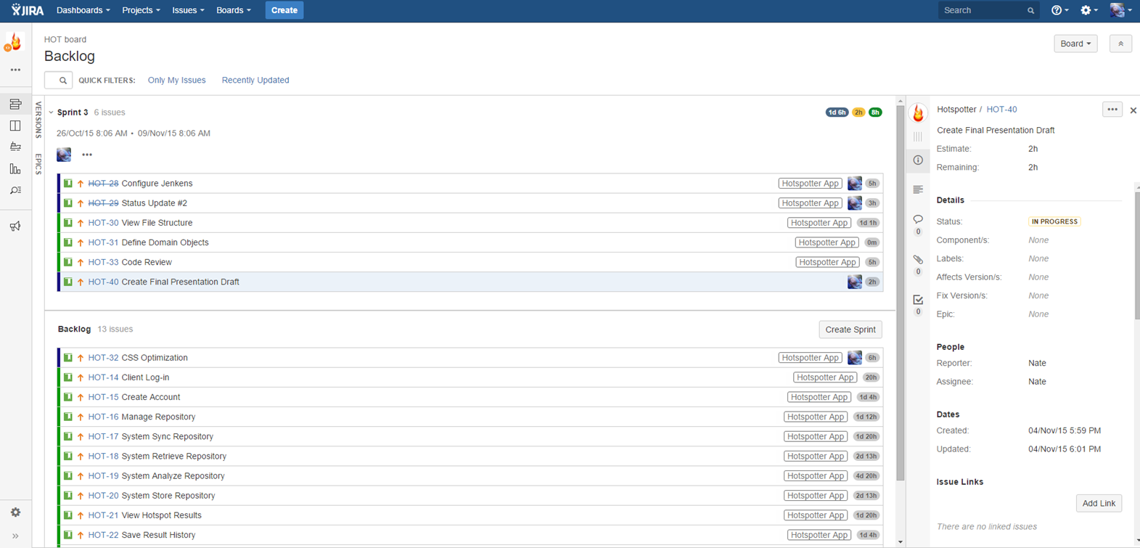
Project Management (Cont.)
Nathan Reinhardt

Slide 10
Team Velocity
Nathan Reinhardt

Slide 11
Team Burndown
Nathan Reinhardt

Slide 12
Post-Mortem
Good
Met all client requirements
Learned to develop with modern web frameworks
Intimate understanding of git version control
Bad
Better time estimation
Burndown spikes and dives
We wish we had longer to work on it!
Nathan Reinhardt

Slide 13
Questions?

